Slide 1
Project Title
3D PRINTER MATERIAL
- Mohd Tabish Nehal
- Murli
- Surya
- Y. Avinash Kumar
- Y. Pavitra

Slide 2
Content
Introduction
Technical Description
EDA
UI
Conclusion

Slide 3
Introduction
3D Printer Material dataset consists of nine independent variables and three dependent variables.
Build a machine learning model
Predict the material used for 3D printing
Study the parameter effect
Calculate the different evaluation metrics

Slide 4
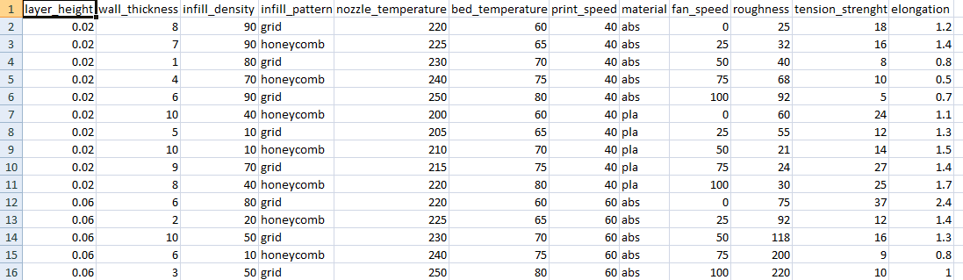
Dataset

Slide 5
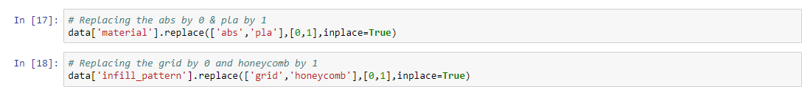
Conversion

Slide 6
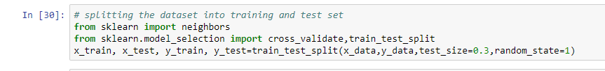
Splitting the dataset

Slide 7
Algorithm
Different Machine Learning Technique has been applied on the training and test data–
1) k Nearest Neighbours
2) Support Vector Classification
3) Decision Tree Classifier
4) Random Forest Classifier

Slide 8
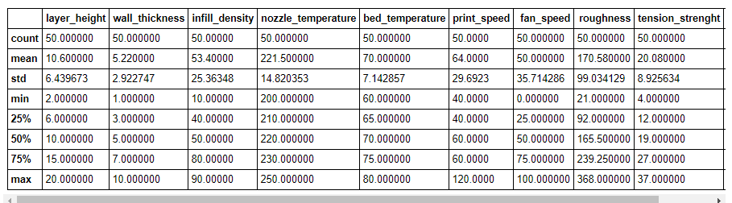
Describe

Slide 9
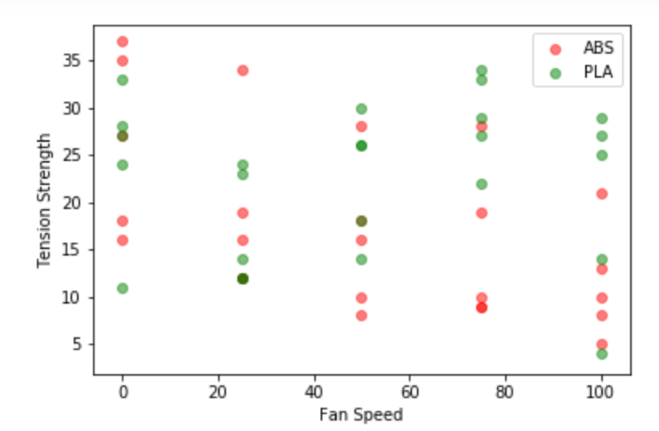
Tension Strength vs. Fan Speed

Slide 10
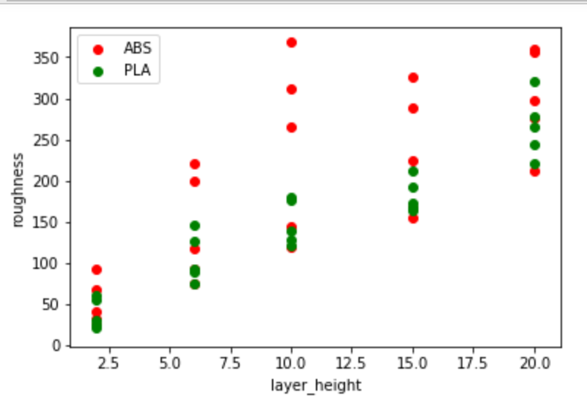
Roughness vs. Layer height

Slide 11
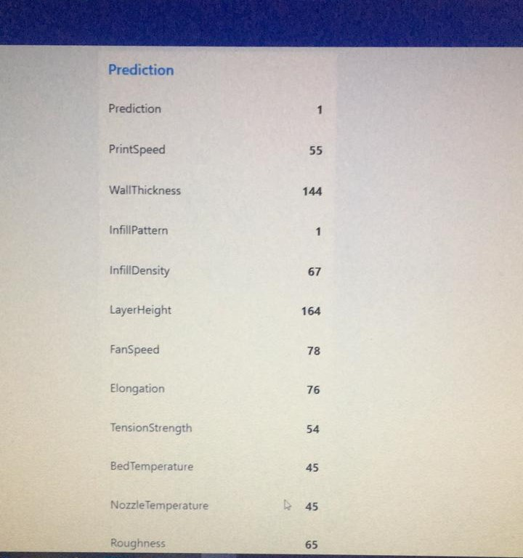
User Interface

Slide 12
Conclusion
Air circulation is not good for ABS
Roughness increases as the layer height increases

Slide 13
Thank you

